Slide 1
AFFINITY Propagation Clustering Algorithm Machine Learning

Slide 2
Agenda
Introduction
Affinity Propagation
What is Affinity Propagation
Pictographical explanation
conclusion

Slide 3

Banish J AI Developer, WEB Developer and APP Developer to know more about me check https://www.banish.in/

Slide 4
AFFINITY PROPAGATION

Slide 5
What is AFFINITY PROPAGATION
Affinity propagation works by sending messages to the exemplar
(an important data point of the cluster which represents the properties of all data points in a cluster).
If the exemplar indicates that a data point belongs to its cluster, the data point assigns itself to that cluster.
Otherwise, the process is repeated for other clusters.

Slide 6
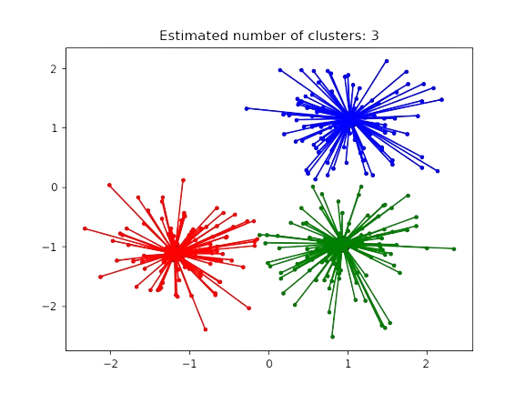
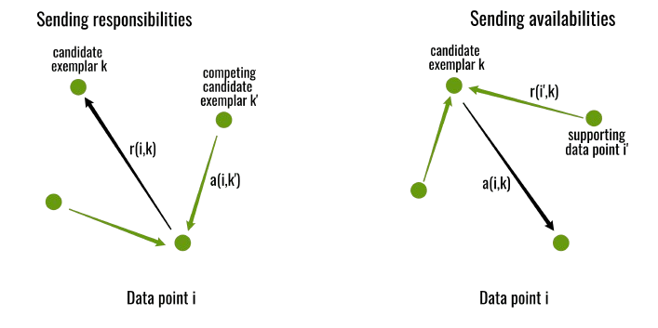
AFFINITY PROPAGATION
Relation
Moving from one place to another

Slide 7
Thank you
Banish J
944-433-3914
mail@banish.in
www.banish.in

